Slide 1

International Conference
International Day of Older Persons
Human Rights of Older Persons in the Czech Republic
Prof. Israel (Issi) Doron
CRSA – Center of Research & Study of Ageing
University of Haifa, Haifa, Israel

Slide 2
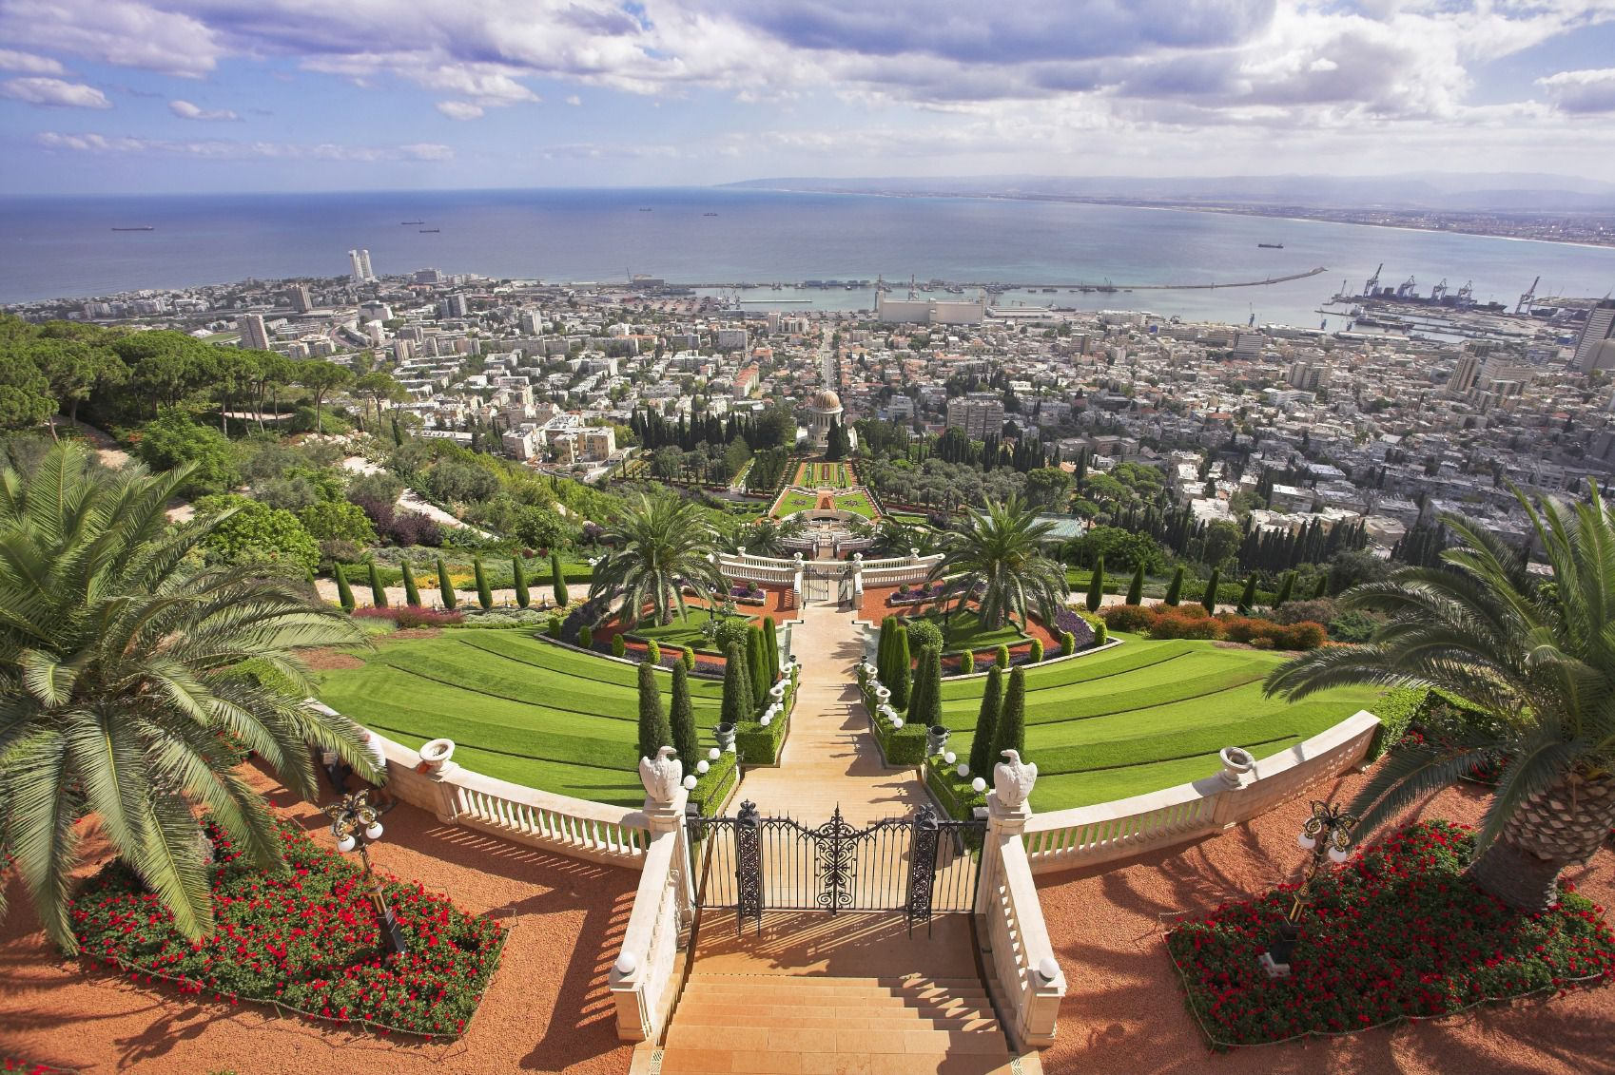
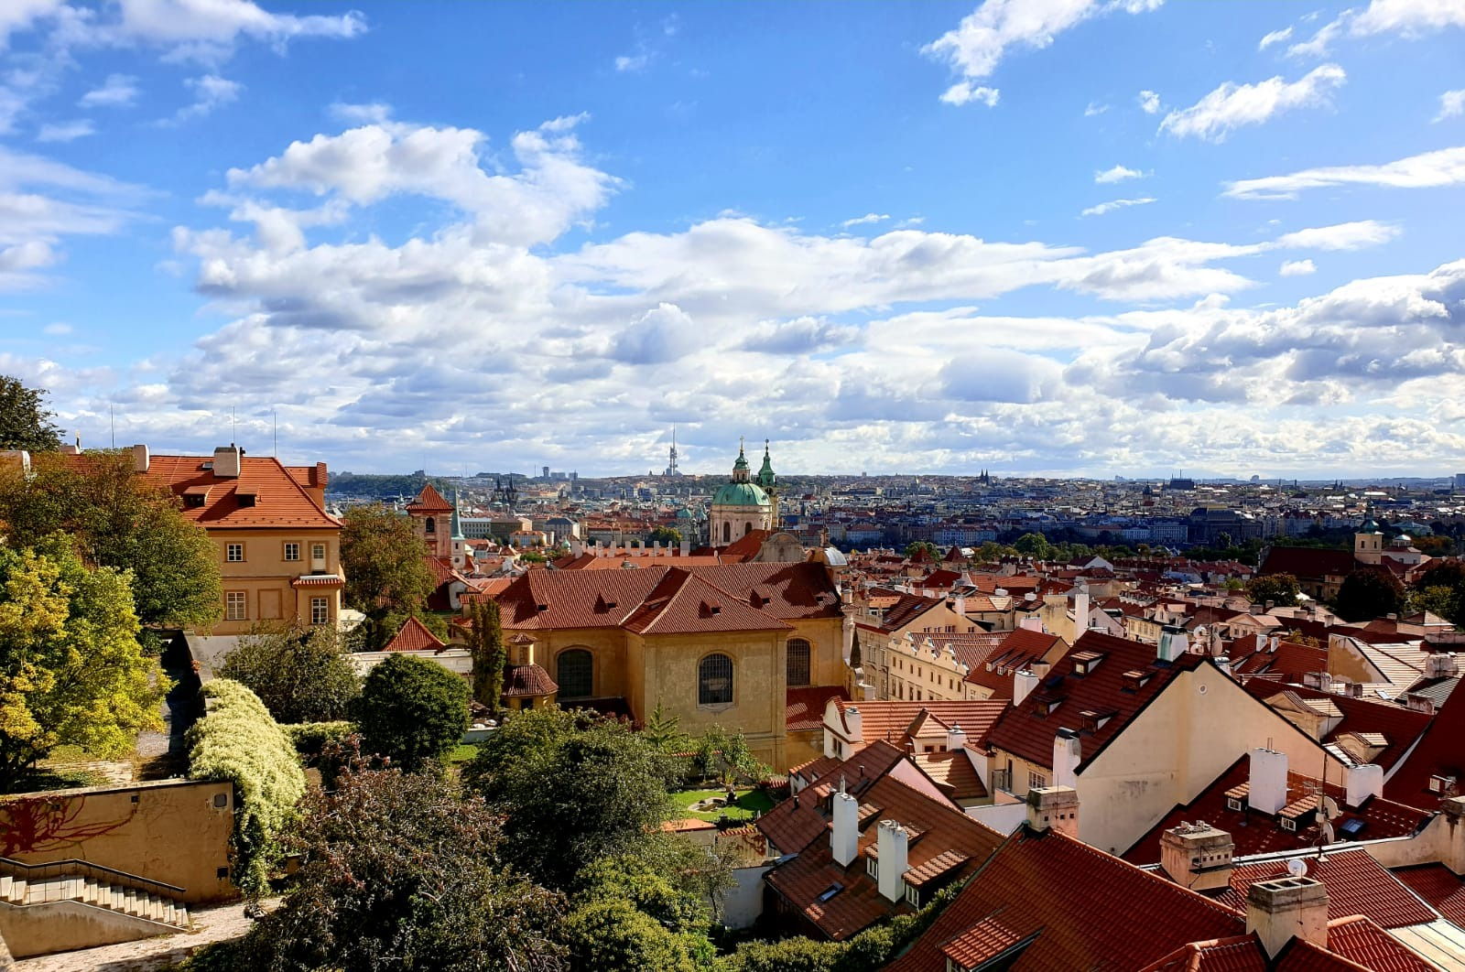

Before Opening
About myself:
  who am I?
  My personal thanks:
    To you, the audience;
    To the organizers;
    To your beautiful city;
About this presentation:
  Coming to Prague
  This presentation:
    A quiz
    A 3 step Argument
    An Ideological statement

Slide 3
An Introductory Quiz

Slide 4
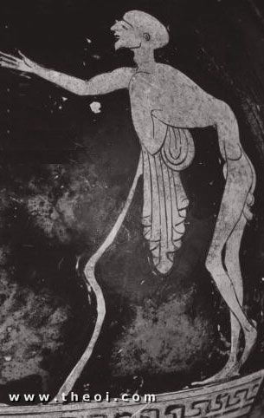
Question 1: Who is this?
Clue? . .
This is: GERAS
One of the bad spirits made by the goddess of night – NYX (who was the opposite of the goddess of youth HEBE)
How is he characterized?
What do we know on the social construction of old age in Ancient Greece?

Slide 5
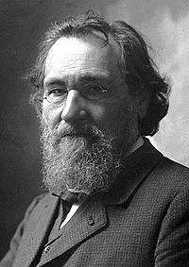
Question 2: Who is this?
Clue?
This is Ilya Ilyich Mechnikov;
Russian Jewish biologist ; Nobel Prize recipient of 1908 for his work in immunology;
He coined the term “gerontology” 1903 after focusing his research on longevity;
How did he “understand” aging?
How did “science” view aging?

Slide 6
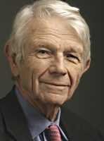
Question 3: Who is This?
  An American Prof….
  Prof. Robert Neil Butler
  “Why Survive? Being Old in America” (Pulitzer Prize 1976)
  What did Prof. Butler’s writings represent?

Slide 7
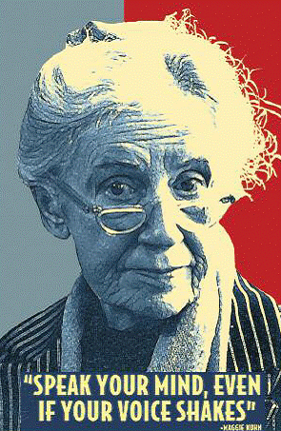
Final Question: Who is This?
  Clue? American….
  Maggie Kuhn
  The founder of “Gray Panthers”
  What did she represent?

Slide 8
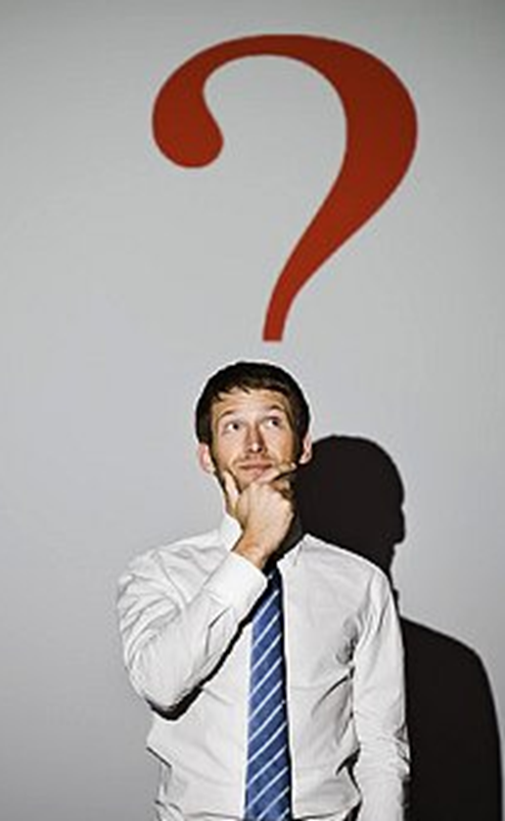
But, What am I saying?
  How is this related to this session?
  What can we learn from this “historical journey” and how is it related to elder abuse and neglect?
  I will try to “connect” this quiz to a 3 steps logical argument.

Slide 9
Logical Step 1

Slide 10
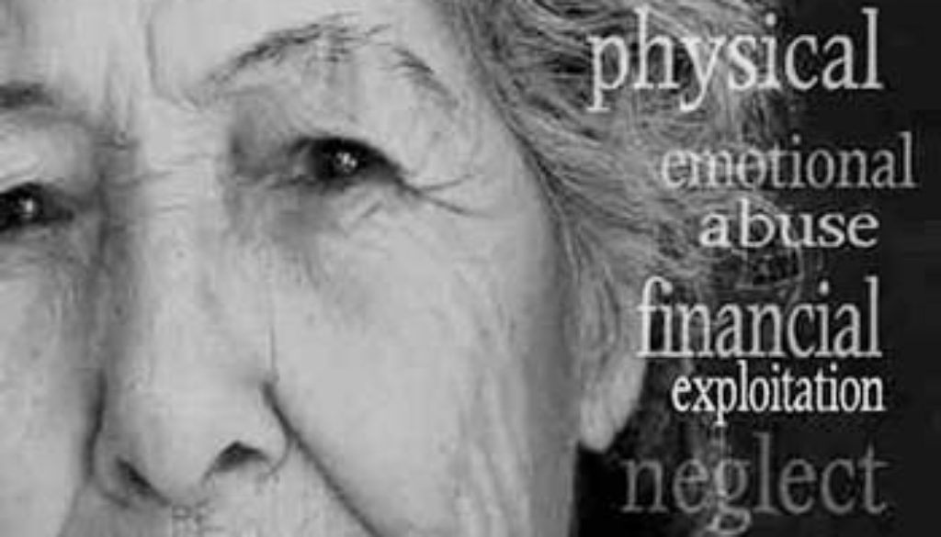
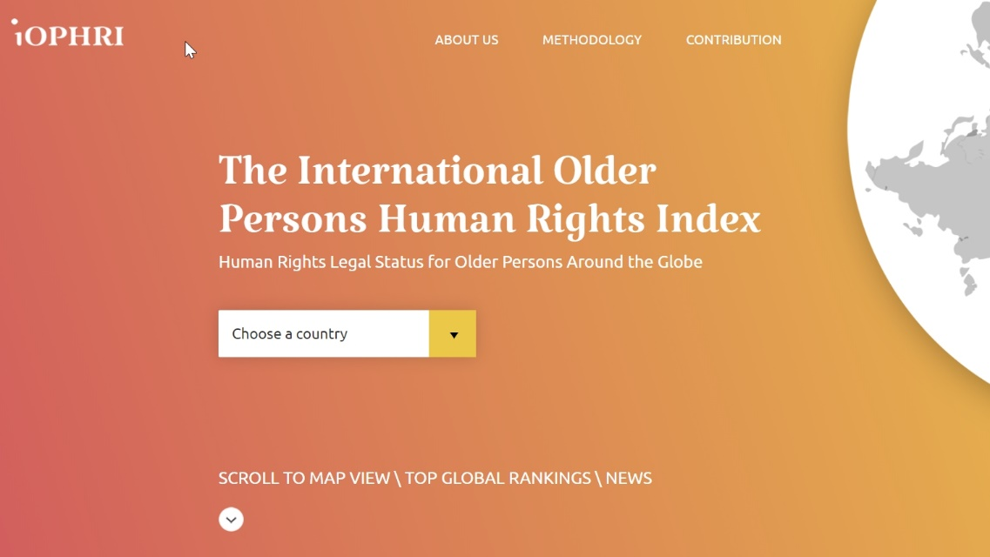
Elder Abuse is a Human Rights Issue
The explosion of knowledge and awareness + the importance of “evidence-based knowledge”;
The IOPHRI Project
The “triviality” of a human rights argument;
The uniqueness of the argument:
  Top down perspective;
    The normative gap;
  Bottom up perspective;
    Symbolic Political Identity

Slide 11
Logical Step 2

Slide 12
Ageism is the Key to the understanding of EA&N
Ageism is central to elder abuse and neglect
A quick reminder:
  Ageism can be seen as a process of systematic stereotyping of and discrimination against people because they are old, just as racism and sexism accomplish this for skin color and gender. Old people are categorized as senile, rigid in thought and manner, old-fashioned in morality and skills [...] Ageism allows the younger generations to see older people as different from themselves, thus they subtly cease to identify with their elders as human beings

Slide 13
Understanding that being “old” is a “social construction”

Slide 14

The centrality of Ageism: The Cultural and Symbolic Recognition Injustice
Ageism – the humiliation of the “elder identity” - is the key element of any future attempt to change the reality of EA&N and to development of human and legal rights to older persons:
  It is unique to older persons;
  It exists in all societies;
  It is manifested in all fields of life;
  It is rooted in culture;
  It is internalized by older persons (self-ageism);
  It will not “vanish” by itself.
  It is complex and ambivalent: both positive and negative;
In my view – it is the source of EA&N

Slide 15
Logical Step 3

Slide 16

The Need for an ideology
So, if we know so much about EA&N, and we also understand the centrality of Ageism, as well as the relevance of HR discourse… what are we still missing?
We are missing an ideology. We are missing ageivism !
Ageivism is the political ideology behind the social movment for social justice to older persons. Ageivism is the foundationl basis for Social Activism and Human Rights in old age.
www.ageivism.org

Slide 17
To summarize my logic argument
I believe that I there is evidence that supports the following:
    Older adults are unique and distinct social group;
    Many older persons experience discrimination, exclusion, abuse and neglect;
    The reason for this is because older persons are “constructed” as an economic “problem”, “burden” and as the “source” of the current “young” people’s socio-economic troubles;
  But no social change was made without a social struggle;
  Without ideology, there is no future for the human rights of older persons in Europe.
  Without a new ideology EA&N will not vanish;
  SO = WHAT WE NEED IS NOT ONLY TO BEING “ACTIVE” OR “SUCCESSFUL” - WE NEED TO BE “ACTIVISTS”
  As Ageivists, we need to be part of the international movement towards a new HR convention for the rights of older persons

Slide 18
To conclude …a symbolic Ageivist gesture

Slide 20
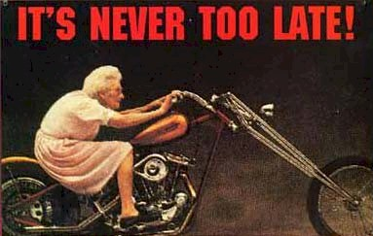
Thank you very much for your kindness.
Prof. Israel Issi Doron
www.ageivism.org

